Slide 1
Introduction to Accessibility

Slide 2
Summary
Return on Investement of Accessibility
Legislation
Auditing/Testing
Manage
Conclusions

Slide 3



The only thing worse than being blind is having sight but no vision.
Hellen Keller
https://france-handicap-info.com/international/actualites-internationales-journees-mondiales/180-journee-mondiale-/5034-le-braille-plus-de-siecles-d-existence-a-t-il-encore-un-avenir-a-l-heure-du-tout-numerique

Slide 4
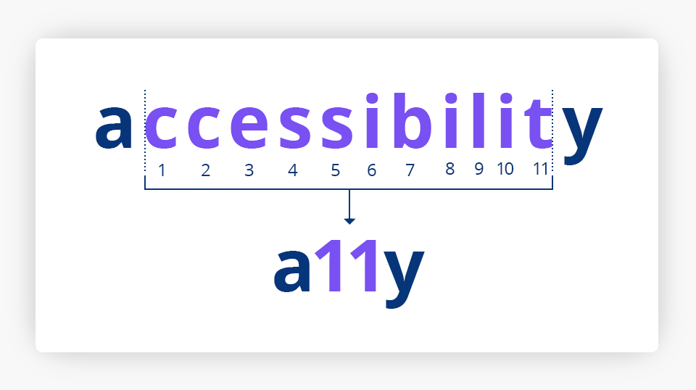
A11y?
https://www.wp-assistance.fr/support-wordpress/accessibilite-numerique-secteur-public/
Notes:
a11y stands for accessibility

Slide 5

1. ROI of Accessibility
Notes:
Accessibility isn’t just about inclusion, it’s also a real business opportunity. It can help reach more users, improve SEO, and reduce development costs in the long run.

Slide 6
Beyond Disability
Around 15% of the population has a disability... Yes, but...
Not everyone goes online / uses a smartphone (especially the mentally handicapped)
Not every handicap is a hindrance (e.g. leg amputation)
Obstacles differ depending on the disability (risk of wanting to address only one disability)
"Not my target audience".
"Only 15%?"

Slide 7

Disability,
and much more
https://www.mon-cafe.com/blog/george-clooney-parle-ch---timi-b497.html

Slide 8
Beyond Disability, accessibility can:
Supporting innovation:
Accessibility features integrated into products and services solve unexpected problems.
Notes:
Accessibility isn’t only for people with disabilities—it benefits everyone. Think about voice assistants like Siri or Alexa. Originally designed for accessibility, now they’re used by millions.

Slide 9

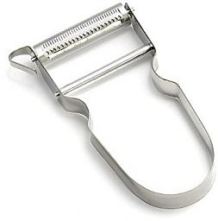
Ready for the future?
https://www.newegg.com/logitech-915-000148x-universal/p/N82E16880111047
https://www.macuisinesante.com/recipe-items/curry-de-courge-butternut-autres-legumes/
Notes:
What is common between a TV remote control and a vegetable peeler?
From an accessibility perspective, the commonality between a TV remote control and a vegetable peeler lies in their design, which is intended for easy use by a wide range of people, including those with physical limitations.
Here are a few aspects to consider:
Ergonomics: Both items may be ergonomically designed to fit comfortably in the hand, making them easier to use for people with dexterity or strength issues.
Ease of Use: They generally feature intuitive characteristics, such as clearly identified buttons on a remote control or a properly aligned blade on a peeler, allowing users to understand and use the device without requiring extensive training. The remote control for tv Iallows users to change channels, adjust the volume, and control other functions without having to move to the TV, which is especially helpful for people with limited mobility.
Accessibility for People with Disabilities: Both objects can incorporate design elements that make them usable by individuals with disabilities. For example, a remote control can have raised buttons for visually impaired users, and a peeler can include a non-slip grip.
By incorporating accessibility principles into their design, these objects become more inclusive, offering an enhanced user experience for everyone, including those living with disabilities.

Slide 10
Ready for the future?
Accessibility is closely linked to overall usability.
Both want to define and serve a more intuitive user experience.
https://www.newegg.com/logitech-915-000148x-universal/p/N82E16880111047
https://www.macuisinesante.com/recipe-items/curry-de-courge-butternut-autres-legumes/
Notes:
This slide highlights the close relationship between accessibility and usability.
Accessibility is not just about compliance but about creating intuitive and usable experiences for all users.
It shows how accessibility has influenced usability and vice versa, to advance progress and provide solutions not just for the disabled community, but so that everyone can benefit from accessibility improvements.

Slide 11

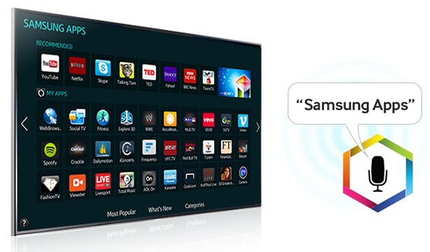

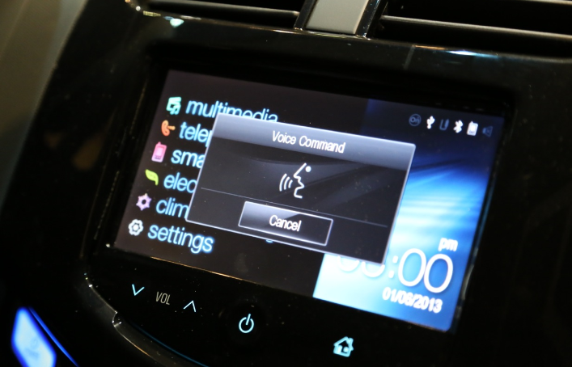
Ready for the future?
Voice interaction
1998
Dragon Speech-to-text
2011
Samsung Smart TV
2013
TESLA
2013+
Dragon Pro
https://www.nuance.com/content/nuance/sites/nl-nl/dragon/dragon-for-pc/home-edition.html
https://www.samsung.com/in/support/tv-audio-video/is-my-voice-or-data-sold-to-third-parties-for-marketing-purposes/
https://www.applesfera.com/ios/siri-eyes-free-sigue-ampliando-su-radio-de-accion-chevrolet-en-el-2014
Notes:
Accessibility has played a key role in the emergence and innovation of these voice technologies.
By making it easier for people with disabilities or motor, visual, or auditory limitations to use their devices, these solutions were designed to meet a need for inclusion, while also driving the development of new natural interfaces.
Voice interaction has thus become a vector for accessibility that has innovated in how we interact with technology, making these devices more intuitive, universal, and adaptable for all users.
Their development illustrates how accessibility has been a catalyst for innovation, expanding interaction possibilities and rethinking the user experience for everyone.

Slide 12

Ready for the future?
Quality code + semantics
Voice interaction
https://www.bol.com/be/nl/p/google-home-smart-speaker-wit-nederlandstalig/9200000100219755/
Notes:
In the field of accessibility, especially with voice assistants like Google Home, the importance of quality code and semantic structure is fundamental to ensuring effective and inclusive voice interactions.
Explanation: High-quality code, following best practices in accessibility, ensures that content structure and behavior are reliable and predictable for assistive technologies. Semantic structure—that is, the proper use of HTML tags or other structuring languages—enables devices like Google Home to understand content accurately and interpret user voice requests correctly.
In other words, well-structured and semantically correct content allows the voice assistant to detect and convert speech into appropriate actions or responses. This also guarantees that content remains accessible to everyone, including those with visual or auditory impairments, by providing precise, relevant, and easily understandable answers.
In summary: Good code quality and a carefully implemented semantic structure make voice interactions more natural, accurate, and inclusive, allowing assistants like Google Home to deliver an optimal user experience that complies with accessibility standards.

Slide 13


Ready for the future?
Quality code + semantics
Machine-machine interaction
Notes:
Quality code ensures that communication between the application and the device is stable, error-free, and that each command or data is processed reliably. Semantics—that is, the correct use of structure and instructions within the code—allows the device to understand the precise context of interactions.
In summary: Good quality code with clear semantics makes machine-to-machine voice interactions more fluid, precise, and accessible, by ensuring that each instruction is correctly understood and executed, even in complex environments or for users with specific needs for autonomy.

Slide 14
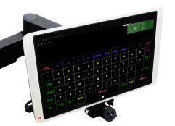
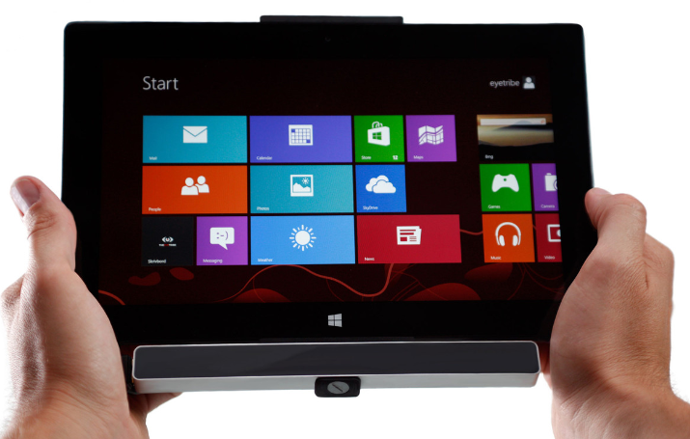
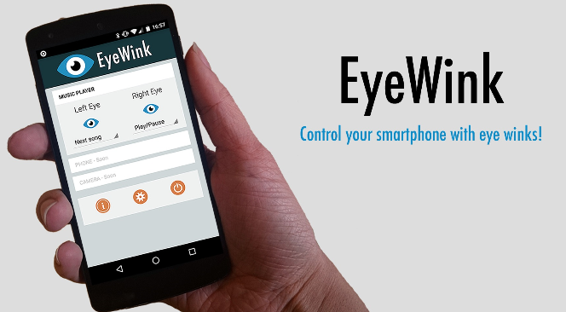
Ready for the future?
Gaze interaction
1986
LC Technologies
2011
Eye Tribe
2015
EyeWink
https://theeyetribe.com/dev.theeyetribe.com/dev.theeyetribe.com/general/index.html
Notes:
Accessibility has been a major catalyst in the development of these gaze interaction or eye-tracking interaction technologies.
Aiming to make computing more accessible and inclusive for people with motor disabilities or other impairments, these innovations have been created to allow control of a computer or device for instance through only eye movements.
Thus, accessibility not only addressed a specific need but also led to innovative solutions that push the boundaries of human-machine interaction. These technologies exemplify this approach: they have turned the necessity of inclusion into groundbreaking technological advancements, offering a more universal and accessible experience for everyone.

Slide 15
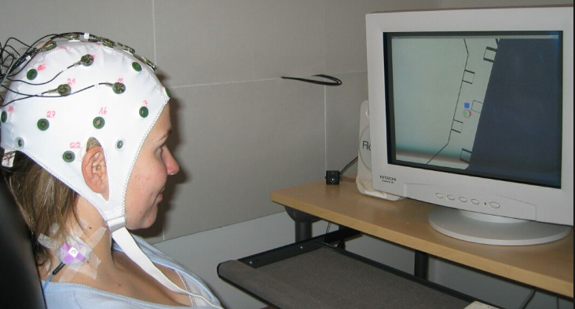
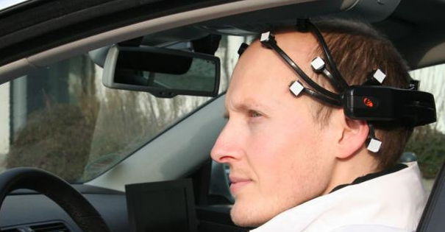

Ready for the future?
Brain interaction
2008
LC Technologies
2011
BrainDriver
2015
Muse
https://www.tecnologiasaccesibles.com/en/catedra/sicse-project
https://www.actinnovation.com/innovation-technologie/brain-driver-conduire-une-voiture-par-la-pensee-1792.html
https://choosemuse.com/?srsltid=AfmBOop7QYRCbA7lv0VOCdmzBrlX3BCB8bcG_bXU6yZ4Ad5KpDmbCWkN
Notes:
We can say that accessibility has been a driving force behind the emergence of these brain-computer interaction technologies. By aiming to make neural interfaces usable by a broader audience, especially for people with motor or neurological impairments, these innovations have transformed assistance needs into real technological advances.
By tailoring these interfaces to meet the specific needs of people with neurological or motor disabilities, these innovations have paved the way for more inclusive usages. Accessibility has thus not only been a necessity but also a genuine driver of innovation, making brain communication more universal, accessible, and deeply innovative.

Slide 16

Accessibility is the NASA of the web
Accessibility,
it's the NASA of the web
https://seeklogo.com/vector-logo/97034/nasa
Notes:
The comparison "Accessibility is the NASA of the web" is a metaphor highlighting the idea that accessibility, like NASA, represents exploration, innovation, and pushing boundaries—particularly within the digital universe. Here's why this analogy can be made:
Pioneering Spirit: Just as NASA is known for exploring uncharted space frontiers, accessibility is about exploring new horizons in human-computer interaction, aiming to include everyone, especially those with disabilities.
Innovation and Advancement: NASA has driven technological innovation that often benefits society at large. Similarly, accessibility drives the development of cutting-edge solutions (like brain-computer interfaces, eye-tracking, voice recognition) that push the limits of technology and usability.
A Quest for Inclusion: NASA’s mission is to explore and expand human knowledge of space. In the digital world, accessibility expands the "space" of technology to include all users, regardless of their limitations, promoting a universal experience.
Complex and Challenging: Just as space exploration involves overcoming significant technical and scientific challenges, creating accessible digital environments requires solving complex problems involving design, technology, and standards—demanding innovation, expertise, and perseverance.
In brief: Saying "Accessibility is the NASA of the web" emphasizes that accessibility is a frontier of innovation and exploration, constantly pushing the boundaries of what’s possible, aiming for inclusivity, and inspiring technological breakthroughs that benefit everyone.

Slide 17

The most famous blind man
is the most famous blind man
https://www.iconfinder.com/icons/7123025/logo_google_g_icon
Notes:
The comparison of Google to "the most famous blind man" in an accessibility approach is a metaphor highlighting how Google, through its products and services, has become a symbol of universal accessibility and inclusivity. Here's why this analogy resonates:
Universal Accessibility: Google’s tools—like search, voice assistants, and screen readers—act as accessible gateways for people with visual impairments, helping them navigate and interact with the digital world effortlessly, much like a blind person relies on familiar guiding tools.
Global Reach and Recognition: As one of the most widely used and recognizable technology companies in the world, Google has set standards for inclusive design, making accessibility a central feature of its ecosystem.
Innovator in Assistive Technology: Google has pioneered and integrated advanced assistive technologies, such as voice recognition, AI-driven image descriptions, and navigational aids, making it a "leader" in accessible solutions.
Symbol of Assistance: The phrase positions Google as a "famous blind man" — a figure that symbolizes a trusted guide, helping all users, especially those with disabilities, to "see" and explore the web, much like the metaphorical blind person navigating the world.
In summary: Saying "Google is the most famous blind man" emphasizes that Google has become an emblem of accessible, inclusive technology—an aid that's widely recognized, relied upon, and essential for navigating the digital universe for everyone, particularly for users with visual impairments.

Slide 18
WCAG ?
Web Content Accessibility Guidelines (WCAG) set the global standard for making digital content usable for everyone, including people with disabilities. While often seen as a developer’s responsibility, WCAG is just as crucial for designers.
Visual elements like color, contrast, typography, and layout directly impact accessibility. By following WCAG, designers ensure their work is inclusive, user-friendly, and compliant.

Slide 19
WCAG Principles for Accessible Web Design ?
Web Content Accessibility Guidelines (WCAG) set the global standard for making digital content usable for everyone, including people with disabilities. While often seen as a developer’s responsibility, WCAG is just as crucial for designers.
Visual elements like color, contrast, typography, and layout directly impact accessibility. By following WCAG, designers ensure their work is inclusive, user-friendly, and compliant.

Slide 20
WCAG Principles
The Web Content Accessibility Guidelines (WCAG) work on four principles—Perceivable, Operable, Understandable, and Robust (POUR).
Here’s how these principles shape accessible design:
1. Perceivable: Content must be presented in ways users can perceive. Add text alternatives for images, captions for videos, and adaptable layouts for different devices and assistive technologies.
2. Operable: Users must be able to navigate and interact with the interface. This includes keyboard accessibility, clear navigation, and avoiding content that causes seizures or physical discomfort.

Slide 21
WCAG Principles
Example:
A user should be able to navigate a website using only a keyboard.
Good Practice: Buttons, menus, and forms can be accessed with the Tab key and activated with Enter/Space.
Why it matters: Some users cannot use a mouse due to motor impairments.

Slide 22
WCAG Principles
3. Understandable: Information and interface must be easy to understand. Use clear language, consistent layouts, and help users avoid and correct errors.
Example:
Form fields are clearly labeled, and error messages are easy to read, explaining how to fix the issue.
Good Practice: A message like “Please enter a valid email address” instead of just highlighting a field in red.
Why it matters: Users with cognitive or learning disabilities benefit from clear guidance.

Slide 23
WCAG Principles
4. Robust: Content must be compatible with current and future user tools—including assistive technologies—by using clean, well-structured code.
Example:
A website uses proper HTML tags so that screen readers can interpret headings, lists, and buttons correctly.
Good Practice: Using <button> instead of a styled <div> for clickable elements.
Why it matters: Assistive technologies rely on semantic code to function properly.

Slide 24
Additional reading
WCAG Guidelines for Creating Accessible Web Design & Benefits of WCAG for Designers :
https://www.browserstack.com/guide/wcag-for-designers

Slide 25

Cross-reference A11Y + Potential market
1. Increasing market reach:
More than a billion people worldwide
live with a disability, which represents
vast untapped market potential.
https://www.ieb-eib.org/nl/nieuws/begin-van-het-leven/eugenetica/personen-met-een-handicap-de-vn-wijst-op-een-liberale-eugenetica-1790.html
An accessible site = open doors to this diverse audience = broaden your customer base = generate revenue.

Slide 26

Cross-reference A11Y + Potential market
2. Improving the user experience:
The "user-friendly" design benefits everyone, not just the disabled.
Accessible websites are often easier to navigate for all users, leading to greater satisfaction, commitment and loyalty to the brand or company.
https://www.mhlnews.com/labor-management/article/22055700/tell-employees-lose-the-emojis
Notes:
The "user-friendly" design benefits everyone because it is built around simplicity, clarity, and ease of use—principles that improve the overall user experience.
When interfaces are intuitive, accessible features such as clear navigation, readable fonts, and straightforward workflows are easier for all users to understand and navigate, regardless of their abilities or limitations.
This universal design approach reduces confusion, saves time, and creates a more efficient and enjoyable interaction for everyone, including the elderly, non-native speakers, or those with temporary impairments, ultimately making digital experiences more inclusive and effective.

Slide 27

Cross-reference A11Y + SEO
3. Improved search engine optimization (SEO):
Search engines like Google reward websites that are accessible.
These sites are propelled higher in search results.
https://seeklogo.com/vector-logo/381721/google-lighthouse
Notes:
Accessibility is essential not only because it ensures that digital content is usable by everyone, regardless of disabilities, but also because it directly influences a website’s visibility and ranking on the web.
Search engines like Google prioritize accessible websites because they provide a better user experience—fast, navigable, and easy to understand—benefiting all users.
When a site adheres to accessibility best practices, it often results in improved SEO performance, higher search rankings, and increased organic traffic, demonstrating that inclusive design is a smart strategy for long-term online success.

Slide 28

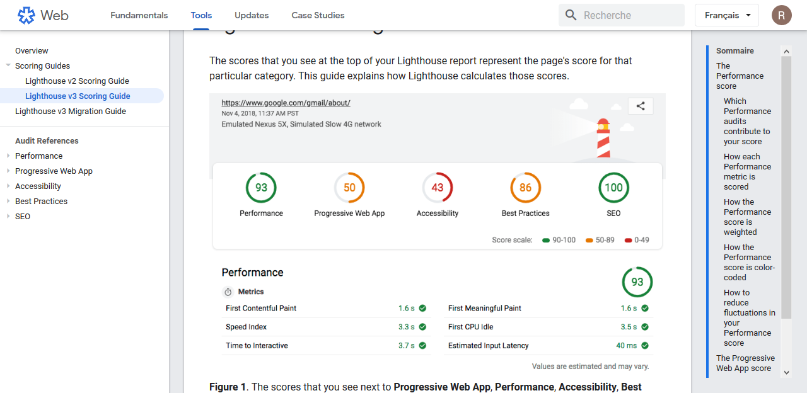
Cross-reference A11Y + SEO
Google Search Quality Evaluator Guidelines - Lighhouse
https://seeklogo.com/vector-logo/381721/google-lighthouse
Notes:
Google Lighthouse is an open-source, automated tool developed by Google that helps developers evaluate the quality, performance, and accessibility of web pages.
Please note, this automated tool will only check a maximum of 30% of the accessibility points.
A comprehensive check requires verification through a combination of automated tools, semi-automated tools, and manual inspection.

Slide 29

Crosscheck A11Y + Cost Dev
4. Reduced development costs:
Integrating accessibility into the development process from the outset is far more cost-effective than integrating it at the end of development.
This proactive approach saves time and resources, and avoids potential legal problems.
https://boomi.com/blog/growing-importance-of-integration-developers/

Slide 30

Crosscheck A11Y + Brand Image
5. Positive brand image:
Demonstrating your commitment to inclusivity through a truly accessible website promotes a positive perception of your brand and company.
Consumers increasingly appreciate companies that focus on responsible and ethical practices, which improves reputation and trust in the brand or company.
https://www.cleanpng.com/png-markkula-center-for-applied-ethics-organization-a-2966304/

Slide 31

Return On Investment: Measurement & Calculation
Calculating the exact ROI of Web accessibility is complex, but several indicators offer valuable information on its overall impact.
https://depositphotos.com/photo/return-on-investment-roi-concept-illustration-122759336.html

Slide 32


Return On Investment: Measurement & Calculation
Increase website traffic: track user visits from various demographic groups and measure growth after implementing accessibility features.
Improve conversion rates: monitor the impact of accessibility changes on user engagement, form submissions and purchases.
Bounce rate reduction: Analyze how long users stay on the website and the impact of accessibility on reducing abandonment.
https://www.pinterest.com/pin/google-logo-google-analytics-png--611434086925786010/
https://seeklogo.com/vector-logo/443589/matomo

Slide 33
Return On Investment: Measurement & Calculation
Improving brand awareness: use online reviews and mentions on social networks to assess user perception and brand image improvement.
Savings: compare the costs of accessibility and compliance testing with the potential legal fees and website redesign costs associated with non-compliance.
https://www.pinterest.com/pin/google-logo-google-analytics-png--611434086925786010/
https://seeklogo.com/vector-logo/443589/matomo

Slide 34
Return On Investment: Measurement & Calculation
Don't forget that the real return on investment in accessibility goes beyond quantifiable measures.
Positive impact on:
brand reputation,
employee morale
and social responsibility
contributes significantly to an organization's overall success.

Slide 35
2. Legislation

Slide 36
Accessibility is not a constraint.
It's a strategy.
https://france-handicap-info.com/international/actualites-internationales-journees-mondiales/180-journee-mondiale-/5034-le-braille-plus-de-siecles-d-existence-a-t-il-encore-un-avenir-a-l-heure-du-tout-numerique

Slide 37




Legislation for the Public Sector
2010
2012
06/2014
10/2016
Proposed legislation for the public sector (WCAG AA)
Proposal for a directive (Commission) on e-inclusion for the public sector (WCAG AA) - without sanctions
Parliament and Council adopt e-inclusion directive for the public sector (WCAG AA)
Regular public reporting
Risk of fine by court requested by citizen
Proposal to add penalties for inaccessible public sites to Americans with Disabilities Act (ADA)

Slide 38
Deadlines for the Public Sector
23 sept '18
23 sept '19
23 sept '20
June 23, '21
New downloadable documents
New intranets and extranets for public institutions
New audios - videos from public institutions
New or updated Apps from public institutions
New public institution sites (Audio-Video excl.)
Only 5% of mobile applications are accessible *.
All former public institution intranets and extranets thoroughly overhauled
All former public institution sites
(older downloadable files and Audio-Video excluded)
All old apps from public institutions that are still used for administrative procedures as of June 23, '21, or that were modified after Sept. 23, '19.
* In Belgium, digital inclusiveness is in a blind spot - Eqla

Slide 39
Legislation for the Public Sector
Who's concerned?
State (regions, communities, federal)
Regional and local organizations (Tax-on-web, STIB...)
Public-sector bodies (CPAS, etc.)
What content needs to be accessible?
Websites, intranet and extranet
Mobile applications
Downloadable documents
Video and audio content
What are the first deadlines?
All new sites set up after September 23, 2018 must be accessible by September 23, 2019, including downloadable documents.
September 2020: all public sites must be accessible.
All videos published after September 2020 must be accessible
June 2021: all public apps must be accessible
Legal texts:
EU: https://eur-lex.europa.eu/legal-content/FR/TXT/HTML/?uri=CELEX:32016L2102&from=EN
BE: http://www.ejustice.just.fgov.be/cgi/article_body.pl?language=fr&caller=summary&pub_date=18-09-03&numac=2018040577

Slide 40
Since 2020...
Few official figures...
September 2021:
The "Collectif Accessibilité Wallonie Bruxelles" (CAWaB) and the non-profit organization Eqla (ex-Œuvre nationale des aveugles) denounce an "unacceptable delay" in this area.
According to the two associations, "95% of public body websites and apps contain flaws that make surfing and, above all, administrative procedures extremely complicated, if not impossible, for people with disabilities".
https://www.rtbf.be/article/accessibilite-numerique-95-des-sites-web-des-services-publics-non-conformes-10847168

Slide 41
Public Sites: The Obligation
Publication of an accessibility declaration, explaining the extent to which the site or application is accessible or not:
Level of compliance with the standard (AA, WCAG 2.2)
What parts of the site or application are not yet accessible and what alternatives are available?
Improvements planned for the short and medium term
How accessibility was tested
Who can people contact if they encounter difficulties, and how?

Slide 42

Additional Obligations
Checks on the SNCB website (https://www.belgiantrain.be/fr):
Publication of an accessibility declaration.
Level of compliance (not compliant, partially compliant, fully compliant)
Target level and standard (A or AA, WCAG 2.1 or 2.2)
What's not accessible
Publication of the current year's action plan.
Indication on the home page whether the site is compliant or not.
The ability for users to easily report accessibility issues.
https://fr.freepik.com/photos-premium/signe-point-interrogation-ampoule-fond-rose_14489402.htm

Slide 43
Disproportionate Load
Conduct an audit + assess compliance costs.
The assessment may result in a "disproportionate burden", i.e. excessive compliance costs, justifying inaccessibility.
Specify in the accessibility declaration which content is not accessible and why.
Art. 6. Public sector bodies may refrain from complying with the accessibility requirements referred to in Article 5 insofar as the measures to be taken to meet them impose a disproportionate burden on the public sector body, taking into account: a) the size, resources and nature of the public sector body concerned, andb ) the estimated costs and benefits to the public sector body concerned in relation to the estimated benefit to disabled people, taking into account the frequency and duration of use of the specific website or mobile application. The public sector body concerned shall make an initial assessment of the extent to which compliance with the accessibility requirements set out in Article 5 entails a disproportionate burden. Where a public-sector body makes use of this derogation, it shall specify, in the declaration referred to in Article 7, which parts of the accessibility requirements could not be met and the reasons for this, and, where appropriate, it shall present accessible alternatives.accessibility requirements have not been met and the reasons for this non-compliance, and, where appropriate, presents accessible alternatives.
http://www.ejustice.just.fgov.be/cgi/article_body.pl?language=fr&caller=summary&pub_date=18-09-03&numac=2018040577

Slide 44
Legislation for the Non-Public Sector
What digital content will be accessible in JUNE 2025?
Transportation services
Telephone service
E-commerce
Banking services
Digital books (e-books) and specialized software
Street furniture transmitting digital information
Services providing access to audiovisual media
NB: the health, hotel, education and insurance sectors are not included.
But they are well within the American ADA, which largely inspires European legislative progress...
Notes:
28/06/2025: companies will be impacted by the European Accessiblity Act (EAA)

Slide 45
Legislation for the Non-Public Sector
How long will it take to comply?
As of June 28, 2025, all new digital products and services (websites, mobile apps, etc.) must comply with the accessibility requirements set by the European regulation, specifically WCAG 2.2 levels A and AA.
For existing platforms, there is typically a gradual compliance period, often until 2028 or 2030, depending on national regulations (For instance: 2028 for France).
This provides companies with several years to audit, correct, and document their site or application, while avoiding penalties. Therefore, it is crucial to start these efforts now to meet the deadline and mitigate risks.
Legal text:
EU: https://eur-lex.europa.eu/legal-content/FR/TXT/HTML/?uri=CELEX:32019L0882&from=EN#d1e2776-70-1
Notes:
Impact Timeline:
Starting June 2025: New products and services must be compliant.
Existing products/services: Companies typically have until around 2028-2030 for gradual compliance, depending on national transposition of the regulation.
Non-compliance can lead to legal penalties, reputational damage, and exclusion from public tenders, so it’s crucial for companies in these sectors to prepare now.

Slide 46
France goes further in Europe (fyi)
Main obligations:
Compliance with RGAA, aligned with WCAG 2.1 AA
Accessibility statements must be published online.
A user feedback mechanism must be available for reporting issues.
Enforcement & Penalties:
Non-compliance can lead to fines up to €50,000.
Organizations must conduct regular audits to ensure accessibility.
Notes:
In France, the transposition of European regulations regarding digital accessibility is mainly carried out through the RGAA (Référentiel Général d’Amélioration de l’Accessibilité).
RGAA is a French regulatory framework transposing the WCAG guidelines into national law.
It specifies how French public websites and digital services must meet accessibility standards—aligning primarily with WCAG 2.1 level AA.
The RGAA includes practical rules, methods for testing compliance, and obligations for reporting and declaration, tailored to the French legal context.
In summary:
WCAG provides the guidelines and technical criteria accepted worldwide.
RGAA is France’s specific implementation of those guidelines, with concrete rules, testing procedures, and legal requirements to ensure compliance within France.
France plans a transition period until the end of 2028, during which existing websites must progressively improve their accessibility.

Slide 47
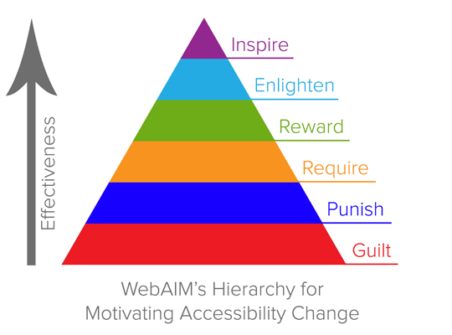
The Most Effective Reason for Accessibility
Guilt: If you cared about people with disabilities, you'd...
Punishment: You risk a fine if you don't.
Requirement: Accessibility is part of UX, period.
Reward: You'll get a badge to display
Illumination: There are plenty of ancillary benefits: for everyone, for Google, for code maintenance...
Inspiration: Accessibility is essential for some, with a real impact on life
https://webaim.org/blog/motivating-accessibility-change/

Slide 48
Accessibility is a state of mind
Accessibility is a state of mind,
not a checklist
https://france-handicap-info.com/international/actualites-internationales-journees-mondiales/180-journee-mondiale-/5034-le-braille-plus-de-siecles-d-existence-a-t-il-encore-un-avenir-a-l-heure-du-tout-numerique
Notes:
We say that "Accessibility is a state of mind, not a checklist" because true accessibility goes beyond simply ticking off a list of technical requirements. It reflects a mindset—or an approach—centered on inclusion, empathy, and the continuous commitment to creating a digital environment that considers the diverse needs of all users.
In other words, accessibility is about embedding inclusive thinking into every stage of design, development, and content creation, rather than just completing a set of predefined tasks. It involves a culture of responsibility and awareness, where designing for accessibility becomes a fundamental value rather than a one-time compliance exercise.

Slide 49
3. Auditing / Testing
Notes:
There are different ways to check if a website is accessible:
Automated tools – quick but only detect some issues.
Manual testing – slower but finds more problems.
User testing – the best way to understand real challenges.

Slide 50
01. Supports and levels
https://france-handicap-info.com/international/actualites-internationales-journees-mondiales/180-journee-mondiale-/5034-le-braille-plus-de-siecles-d-existence-a-t-il-encore-un-avenir-a-l-heure-du-tout-numerique

Slide 51


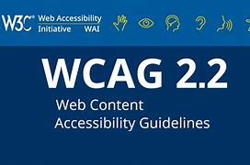
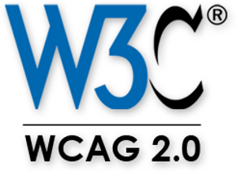
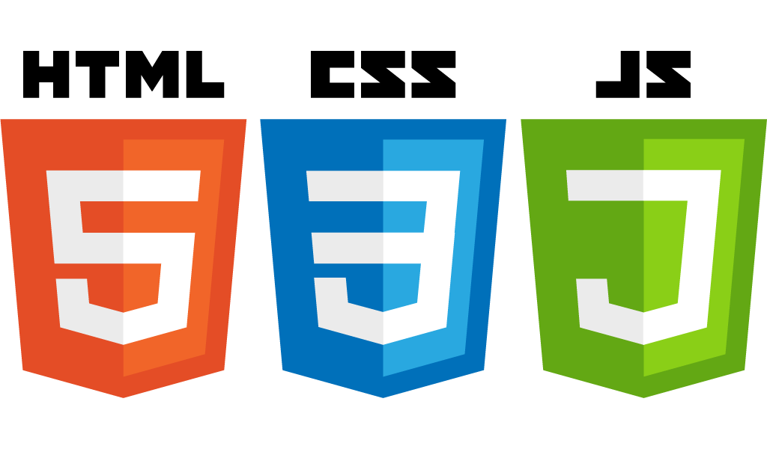


01. Supports and Levels | The origin of the guidelines
Disability
Tools
International rules
European rules
WCAG 2.2
Source : https://simple.wikipedia.org/wiki/Disability https://itaccessibility.uiowa.edu/articles/2023/10/w3c-officially-recommends-wcag-22
Notes:
The EAA (European Accessibility Act) currently requires that websites and mobile applications comply with WCAG 2.1 at the AA level.
However, WCAG 2.2 was published in October 2023, but it has not yet been officially incorporated into European or national legislation.
It is therefore likely that, in the near future, compliance will need to evolve towards WCAG 2.2, especially when regulations are revised or updated.
In summary, the EAA currently mandates WCAG 2.1, and the adoption of WCAG 2.2 is forthcoming.

Slide 52

01. Supports and Levels | Choose the level you want to reach
AAA
WCAG 2.2
Advanced specifications
Accessible and easy to use, even for people with more severe disabilities
E.g.: reinforced contrast rules, sign language, etc.
AA
A
Medium specifications
Accessible and easy to navigate
Ex: minimum contrast rules
Mininum specifications
Most content is accessible, but not easily (e.g. no contrast constraints)
Source : https://en.wikipedia.org/wiki/Web_Content_Accessibility_Guidelines

Slide 53
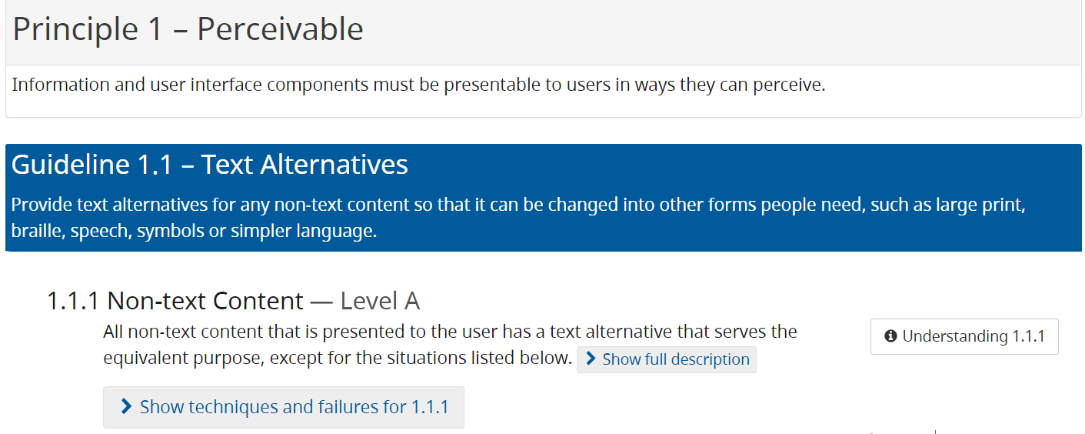
Check WCAG Compliance
Level
Scope of application
The Web Content Accessibility Guidelines (WCAG)
4 principles
Perceptible, usable, understandable, robust
13 guidelines
50 success criteria A+AA
Hundreds of techniques...
How to correct (must and could)
Avoid
Beneficiaries
Source : https://www.w3.org/WAI/WCAG22/quickref/

Slide 54
The European Accessibility Directive
The European directive
don't ask
to label a site
Notes:
The European Accessibility Directive (such as the EU Web Accessibility Directive 2016/2102) does not explicitly require that websites be labeled with an accessibility badge or label.
However, it requires public sector websites and mobile applications to publish a public accessibility statement that details their level of compliance, ongoing efforts, and contact information for user feedback.
In other words, while there's no formal label or badge mandated, transparency and information about accessibility are compulsory, allowing users to understand the level of accessibility and how to access support if needed.
To publish an accessibility statement is a good way to show what kind of effort are made by the companies or organizations, it details their level of compliance, ongoing efforts, and contact information for user feedback.

Slide 55
02. Select
https://france-handicap-info.com/international/actualites-internationales-journees-mondiales/180-journee-mondiale-/5034-le-braille-plus-de-siecles-d-existence-a-t-il-encore-un-avenir-a-l-heure-du-tout-numerique
Notes:
When conducting an accessibility audit, selecting the right pages is crucial to effectively evaluate the site’s compliance.

Slide 56
02. Select pages
A sample of 20-25 pages
Page templates
Different information formats
Video
Documents to download
…
Pages for disabled visitors

Slide 57
02. Select pages
Indispensable pages
Pages and functions accessible from header/footer and menu (home page, search, contact, etc.)
Pages accessible from the home page (menu)
Pages with high business value
Purchase funnel
Forms
Recording
…
A sample of 20-25 pages
Notes:
Summary:
Focus on high-traffic and critical pages
Cover different content types and functionalities
Prioritize user journey touchpoints
Limit to a manageable number, representative of the entire site
This approach ensures your audit is both thorough and efficient, providing accurate insights into your site's accessibility status.

Slide 58
02. Select files
Min 1 file per type
Source : https://fr.m.wikiversity.org/wiki/Fichier:Word_2013_Icon.PNG…..
Notes:
When auditing a website’s accessibility, files like PDFs, Word documents, and other downloadable content are also important components to assess.
Summary:
Select key and frequently accessed files, especially those providing vital information
Cover various formats and content complexities
Focus on documents linked from high-traffic pages
Ensure they meet accessibility standards such as WCAG for PDF/Office files
Incorporating downloadable content assessment ensures a comprehensive view of your site's overall accessibility and helps prioritize remediation efforts effectively.

Slide 59
03. Automated testing
https://france-handicap-info.com/international/actualites-internationales-journees-mondiales/180-journee-mondiale-/5034-le-braille-plus-de-siecles-d-existence-a-t-il-encore-un-avenir-a-l-heure-du-tout-numerique
Notes:
When conducting an accessibility audit, selecting the right pages is crucial to effectively evaluate the site’s compliance.

Slide 60
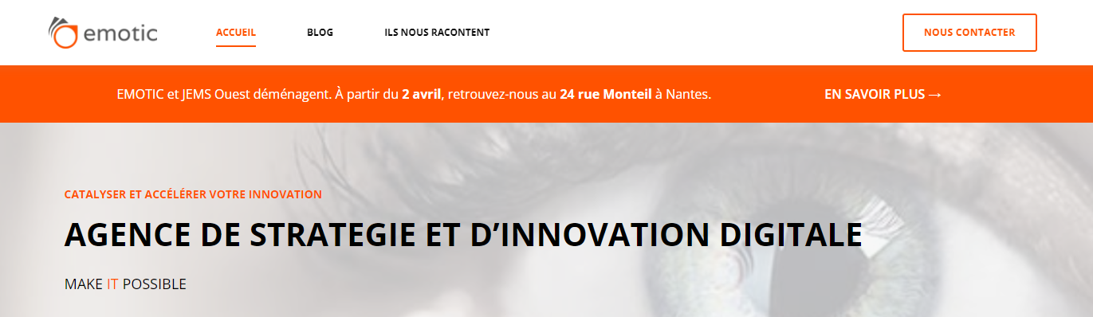
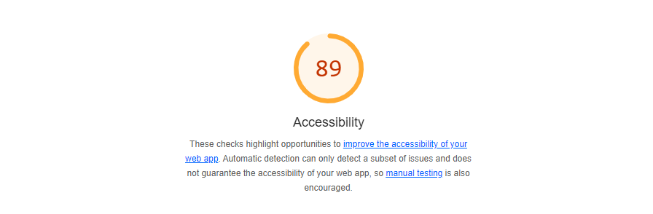

Automated Testing
Lighthouse Chrome Add-on
https://indexedev.com/post/maximizing-page-speed-insight-resolving-the-user-scalable-no-meta-viewport-error/#google_vignette
Notes:
Automated testing plays a valuable role in accessibility audits
Benefits of Automated Testing:
Efficiency: Quickly scans large parts of your website or content to identify common accessibility issues.
Consistency: Provides uniform checks against established guidelines like WCAG 2.1 or 2.2.
Early Detection: Helps catch issues such as missing alt text, color contrast problems, missing labels, and faulty HTML structures.

Slide 61
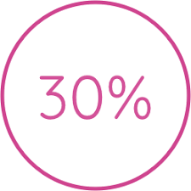
Automated Testing
Automated tests = score on up to 30% of the site
Notes:
but it has its limitations....
Partial Coverage: Automated tools typically cover about 30-40% of total accessibility criteria.
Context-Specific Issues: They cannot evaluate content that requires human judgment, such as readability, cognitive load, or context appropriateness.
False Positives/Negatives: Tools may flag issues that aren’t real (false positives) or miss subtle problems (false negatives).
Best Practice:
Use automated tools (like Axe, WAVE, Lighthouse, Tanaguru) as initial scans to quickly identify obvious issues.
Follow up with manual testing by experts for complex, nuanced, or subjective criteria, such as keyboard navigation, focus states, and screen reader compatibility.
Combine both methods for a comprehensive and accurate accessibility assessment.
Conclusion:
Automated testing is a valuable first step but cannot replace manual review. Combining both approaches ensures thorough coverage and reliable results.

Slide 62
04. Semi-automated testing (add-ons + manual testing)
https://france-handicap-info.com/international/actualites-internationales-journees-mondiales/180-journee-mondiale-/5034-le-braille-plus-de-siecles-d-existence-a-t-il-encore-un-avenir-a-l-heure-du-tout-numerique
Notes:
Semi-automated testing—using add-ons, browser extensions, and manual checks—serves as a crucial complement to automated accessibility audits.

Slide 63
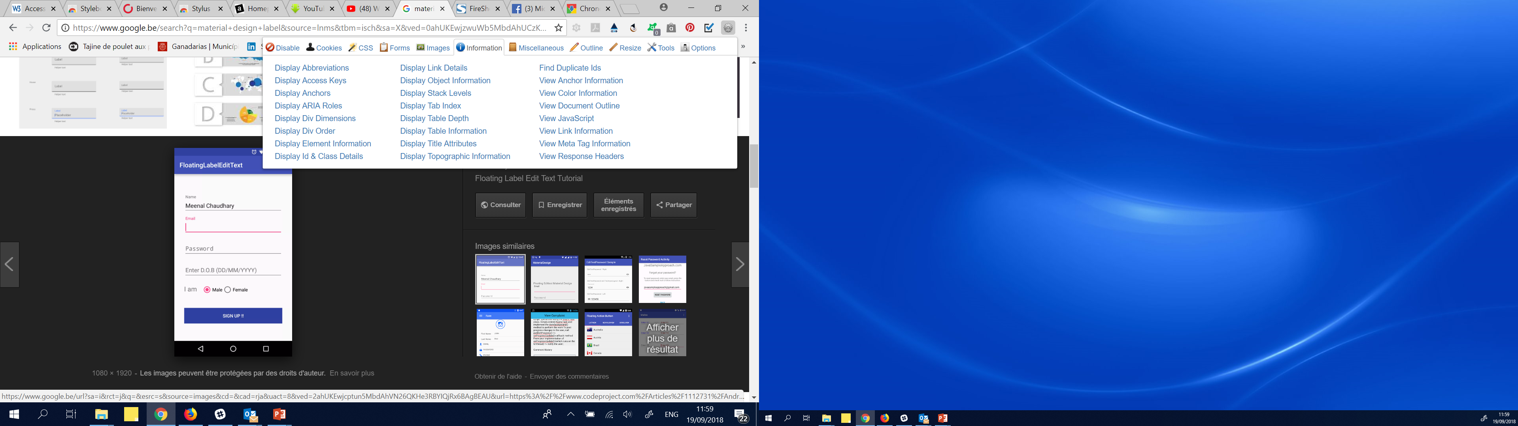
Semi-Automated Testing
Web developper toolbar - Chrome
https://seoandcopywriting.com/guia-encabezados-hn/
Notes:
The Web Developer Toolbar on Chrome is a collection of tools and features, often available through extensions like axe DevTools, WAVE, or native Chrome DevTools panels, that assist website developers in analyzing and improving web accessibility.
Developers can inspect elements directly on the page, see accessibility violations, and get instant guidance on how to fix them.

Slide 64
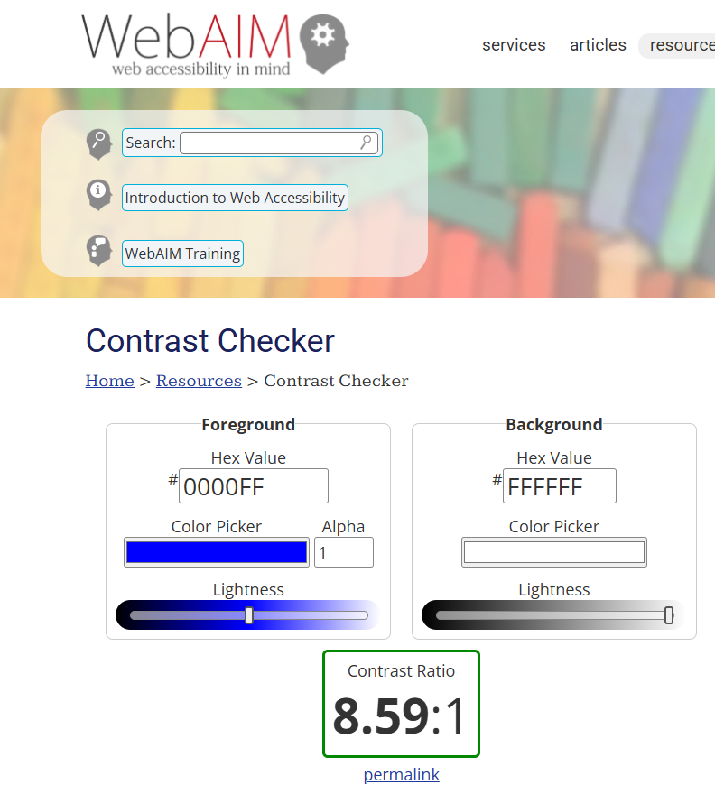
Semi-Automated Testing
https://webaim.org/resources/contrastchecker/
Notes:
Contrast and color use are vital to accessibility.
Users, including users with visual disabilities, must be able to perceive content on the page.
Contrast is a measure of the difference in perceived "luminance" or brightness between two colors.

Slide 65
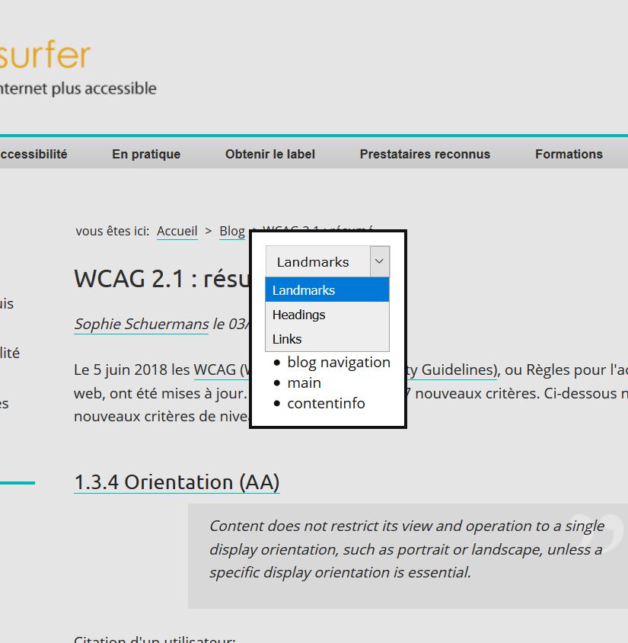
Semi-Automated Testing
Firefox add-on a11y-outline
Notes:
The Firefox add-on "a11y-outline" is a browser extension designed to help web developers and accessibility testers visualize and analyze the HTML structure of a webpage from an accessibility perspective.
a11y-outline is a useful tool for visualizing and validating the semantic structure of a webpage
Semi-automated testing bridges the gap between fully automated tools and manual testing, providing a nuanced and practical approach to accessibility audits.
It greatly enhances accuracy and helps ensure that the site truly meets accessibility standards.

Slide 66
05. Simulations
https://france-handicap-info.com/international/actualites-internationales-journees-mondiales/180-journee-mondiale-/5034-le-braille-plus-de-siecles-d-existence-a-t-il-encore-un-avenir-a-l-heure-du-tout-numerique

Slide 67


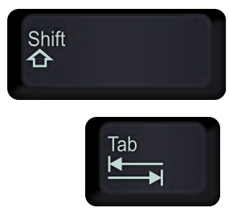



Simulation - Exploratory Check
Keyboard navigation
200% zoom
+
NVDA
VoiceOver
Motionless
With finger
Without sound
Notes:
In the context of accessibility targets, simulations like NVDA, VoiceOver, Zoom, and others are tools used to simulate how users with different disabilities experience digital content.
These tools help developers, designers, and testers understand how accessible a website or app is by mimicking the perspective of users with visual, auditory, or motor impairments.
NVDA (NonVisual Desktop Access): A free screen reader for Windows that reads out content, helping check how visually impaired users navigate and understand the site.
VoiceOver: Apple’s built-in screen reader for macOS and iOS devices, used to test how visually impaired users experience content on Apple devices.
Zoom: Accessibility feature that enlarges content, useful for users with low vision to ensure text and elements are readable at different magnifications.
Other tools: Similar tools include TalkBack (Android), ZoomText (magnification and reading), and speech synthesis systems.
Their role in accessibility targets:
Evaluate usability: These simulations allow developers to verify if all content is perceivable, operable, and understandable for users with disabilities.
Identify issues: By experiencing content as these tools do, teams can detect missing supports, poor contrast, non-navigable elements, or confusing layouts.
Improve design: They guide adjustments, ensuring compatibility and usability for all, especially those relying heavily on assistive technologies.
Conclusion:
Using these simulations as part of the testing process helps ensure that digital content truly meets accessibility standards, making products inclusive and usable by everyone, regardless of their abilities.
...

Slide 68
06. User tests
https://france-handicap-info.com/international/actualites-internationales-journees-mondiales/180-journee-mondiale-/5034-le-braille-plus-de-siecles-d-existence-a-t-il-encore-un-avenir-a-l-heure-du-tout-numerique
Notes:
user tests (or user testing with people with disabilities) are a critical step to evaluate how well your website, app, or digital content meets the needs of users with various impairments.

Slide 69
User Tests
Why make them?
Empathy has its limits (how can you really imagine the difficulties of a blind person?).
You already know the site. Even if you're browsing "blind", you already know what content to expect.
You don't have a full command of technical support tools.
You'll never forget your disabled user test.

Slide 70
User Tests
What to test, when, with whom?
Non-clickable HD mockup with real text: we test the comprehensibility, legibility and intuitiveness of zonings.
> People who are deaf from birth, dyslexics, senior citizens, autistic people, people with concentration problems...
> People with color blindness and other mild visual impairments
> Screen enlarger users
Clickable HD prototype: testing interaction without personalization
> Impaired fine motor skills (mouse) (Parkinson's, arthritis...)
Site staging: testing interactivity and machine-friendliness
> Blind people

Slide 71

User Tests
Challenge #1: profiling
Meet at least
a blind person
a visually impaired person
a senior citizen
https://commons.wikimedia.org/wiki/File:Q10874_noun_3918_ccJordanDelcros_blind.svg

Slide 72
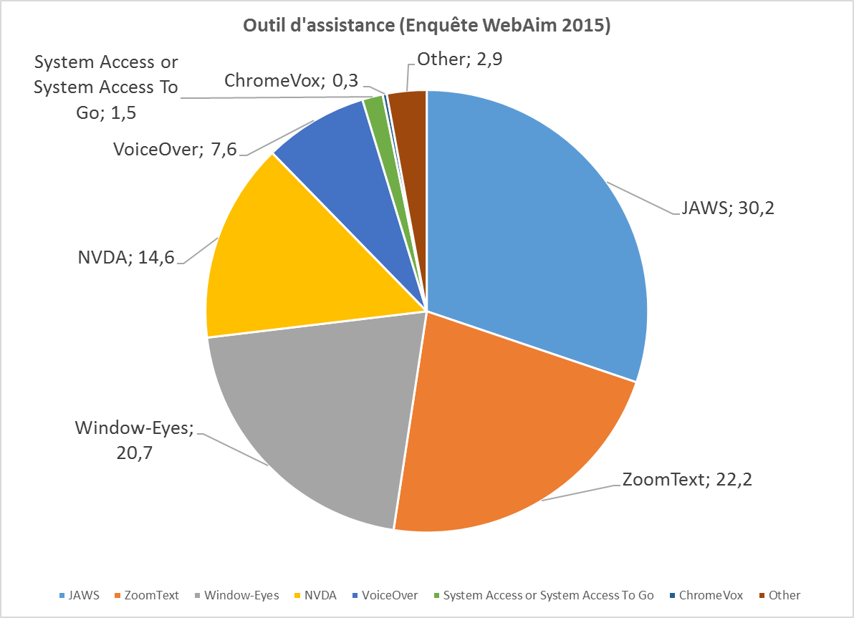
User Tests
Challenge #2: a multitude of tools
Test with participant's equipment
Source : https://webaim.org/projects/screenreadersurvey4/

Slide 73

User Tests
Challenge #3: recruitment
Contact associations, specialist forums, tool forums
Source : Google
Notes:
Accessibility Targets Addressed:
Perceivable: Are the content and controls perceivable by users with visual or auditory impairments? For example, screen reader users rely on proper labeling and structure.
Operable: Can users with motor disabilities navigate and operate the site using keyboards or assistive devices? User testing can reveal if controls are accessible without a mouse.
Understandable: Is the content clear and easy to comprehend for users with cognitive disabilities? Feedback helps improve clarity and usability.
Robust: Does the site work well across different devices and assistive technologies? User feedback ensures compatibility.
How it supports accessibility targets:
Real-world validation: It confirms that accessibility features are practical and effective for actual users with disabilities.
Identifies usability barriers: Helps to uncover issues like confusing layouts, non-intuitive navigation, or missing interaction cues that automated tests might miss.
Guides improvements: Provides actionable insights to refine design and development, ensuring the product is truly inclusive.
Conclusion:
User testing with individuals with disabilities is vital for achieving inclusive accessibility targets, ensuring that digital experiences are genuinely usable by all, not just compliant on paper but effective in real-world use.

Slide 74
07. Audit Report
https://france-handicap-info.com/international/actualites-internationales-journees-mondiales/180-journee-mondiale-/5034-le-braille-plus-de-siecles-d-existence-a-t-il-encore-un-avenir-a-l-heure-du-tout-numerique
Notes:
An audit that combines automatic, semi-automatic, and manual testing, along with user tests, provides a comprehensive assessment of your digital content’s accessibility.

Slide 75
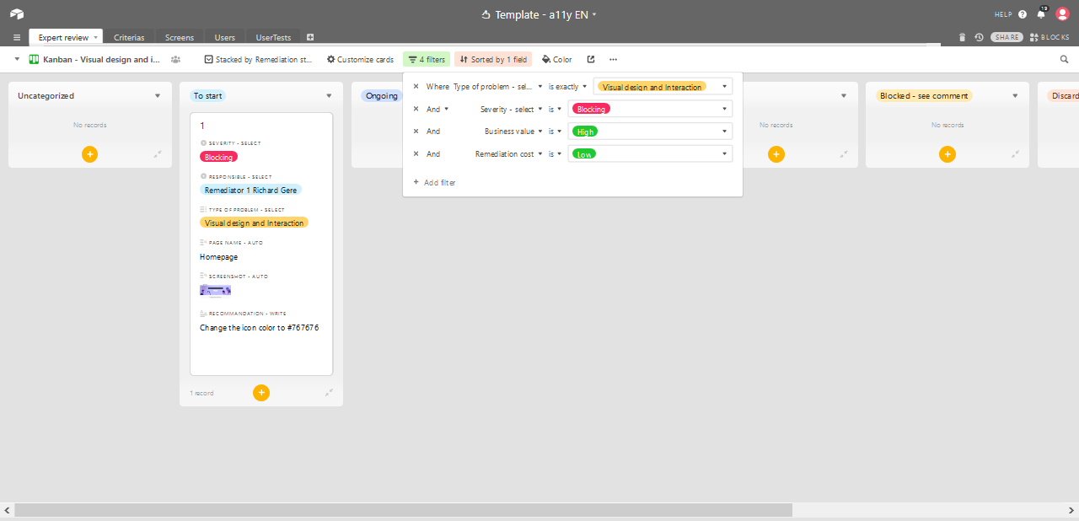
Conclusions of Expert + User Tests
ANAIS 2023. ALL RIGHTS RESERVED
Sorted by correction manager
Filter by priority
94
Notes:
Example of a presentation that shows the issue, why it is an issue, the recommandation to correct the problem, which team will correct (dev, design, editorial), and the priority of the issue (if it is a blocking, major or minor issue).

Slide 76
04. Manage

Slide 77
01. Budget
https://france-handicap-info.com/international/actualites-internationales-journees-mondiales/180-journee-mondiale-/5034-le-braille-plus-de-siecles-d-existence-a-t-il-encore-un-avenir-a-l-heure-du-tout-numerique
Notes:
An accessibility budget refers to the allocated resources—financial, human, and time—that an organization commits to achieving and maintaining accessibility compliance across its digital assets.

Slide 78
Budget
Fixing an inaccessible site can be expensive...
But including accessibility right from the site's creation greatly reduces the cost.
Don't forget that accessibility makes the site
Better referenced
More usable for everyone
More compatible with recent and future interaction methods
Easier to manage, correct...
Notes:
Having a clear accessibility budget allows companies to plan effectively, prioritize remediation efforts, and ensure ongoing compliance, especially in anticipation of regulations like the EU's 2025 deadline.
It also helps avoid surprises or underfunding, ensuring that accessibility remains an ongoing priority rather than a one-time expense.
Ultimately, a well-defined accessibility budget demonstrates a strong organizational commitment to inclusivity, improves user experience for all, and mitigates legal and reputational risks.

Slide 79
Accessibility Priorities
Problem severity (high user value)
High cumulative value
Cumulative value
Remediation priority
2
2
1
4
1
4
5
3
5
3
High business value
Low cost
Source : JEMS
Notes:
An accessibility budget tailored to the severity of issues and their value can optimize resource allocation.
Prioritizing high-severity problems that have a high user value ensures that the most critical barriers for users are addressed first, creating an immediate positive impact on user experience.
Combining this with issues that offer high business value and high cumulative value maximizes ROI, as solving these problems can lead to increased engagement, satisfaction, and compliance benefits—often at a relatively low cost when planned strategically.
This approach helps organizations focus on impactful, cost-effective solutions that deliver maximum benefit for both users and the business.

Slide 80
Anticipate to Avoid Correction
Training
Don't think you're born with it
Don't think it's taught in the classic courses
Tooling
CMS for accessible code
Automatic and semi-automatic test tools
Design system validated for accessibility
Validated style guide for accessibility
Text elements for multilingual templates
…
Notes:
Having accessibility trainings is crucial because they empower teams with the knowledge and skills needed to design, develop, and maintain digital content that is inclusive for all users, including those with disabilities.
Training ensures everyone understands accessibility standards and best practices, reducing the risk of non-compliance and costly remediation later.
It promotes a culture of inclusivity, fosters innovation, and helps organizations meet legal requirements more efficiently.
Ultimately, well-trained teams create better user experiences, expand their reach, and demonstrate a genuine commitment to social responsibility.
It's important to have accessibility tools because they enable organizations to identify and fix accessibility issues more efficiently and accurately.
For instance, automated tools quickly detect common problems, saving time during audits.
They help maintain compliance more consistently and reduce the risk of legal penalties.
Additionally, accessibility tools support ongoing monitoring and validation, empowering teams to build inclusive digital environments that serve all users effectively.
Ultimately, they make accessibility more manageable, reliable, and scalable across projects.

Slide 81
02. Time and employees
https://france-handicap-info.com/international/actualites-internationales-journees-mondiales/180-journee-mondiale-/5034-le-braille-plus-de-siecles-d-existence-a-t-il-encore-un-avenir-a-l-heure-du-tout-numerique
Notes:
An accessibility budget refers to the allocated resources—financial, human, and time—that an organization commits to achieving and maintaining accessibility compliance across its digital assets.

Slide 82
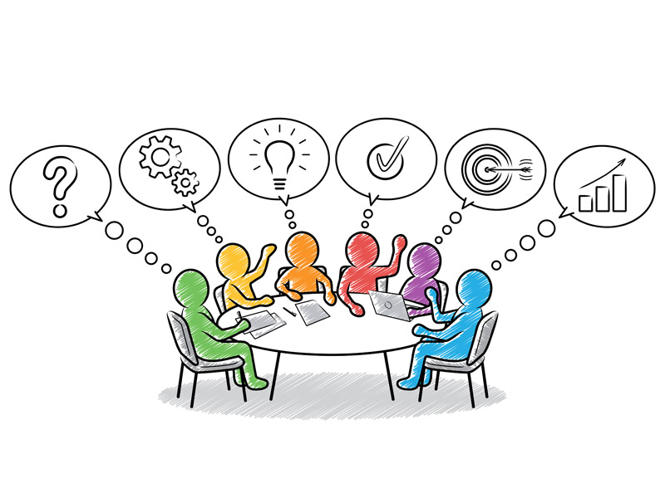
Anticipate to Avoid Correction
Who are our employees involved
In accessibility projects ?
https://stock.adobe.com/be_fr/search/images?k=meeting+comic
Notes:
It is important to identify the employees involved in accessibility projects because doing so ensures that those responsible for implementing and maintaining accessibility are fully engaged and equipped with the necessary knowledge.
This targeted involvement fosters greater ownership, encourages collaboration, and helps ensure that solutions are practical, effective, and sustainable.
Ultimately, involving the right employees leads to higher quality of implementation, promotes a culture of inclusion, and demonstrates the organization’s commitment to accessibility at all levels.

Slide 83
Anticipate
Raising employee awareness
Editors, who write accessible text
Designers, who create accessible interfaces
Developers, who will develop accessible code
Project managers, who will plan accessibility
Managers, who will train and equip teams and include the cost of accessibility.
…
Notes:
Accessibility isn’t something you add at the end—it should be part of the process from the start. It’s a shared responsibility between designers, developers, project managers...
The employees involved in accessibility projects typically include:
Developers and IT Teams: Responsible for implementing technical accessibility features, ensuring WCAG compliance, and maintaining accessible code.
Designers and UX/UI Teams: Charged with creating inclusive, user-friendly interfaces that consider accessibility principles from the outset.
Project Managers (PMs): Oversee the planning, coordination, and delivery of accessibility initiatives, ensuring deadlines and standards are met.
Content Creators (Copywriters, Content Managers): Ensure that text, images, and multimedia content are accessible—such as providing alt text and proper headings.
Marketing and Communication Teams: Responsible for accessible outreach and ensuring that public-facing content, like declarations and reports, are inclusive.
Top Management and Leadership: Support and champion accessibility policies, allocate resources, and foster a culture of inclusion.
HR and Training Managers: Responsible for training staff, raising awareness, and integrating accessibility into ongoing professional development.
Involving these key roles ensures that accessibility is integrated throughout the organization from design to deployment and beyond.

Slide 84
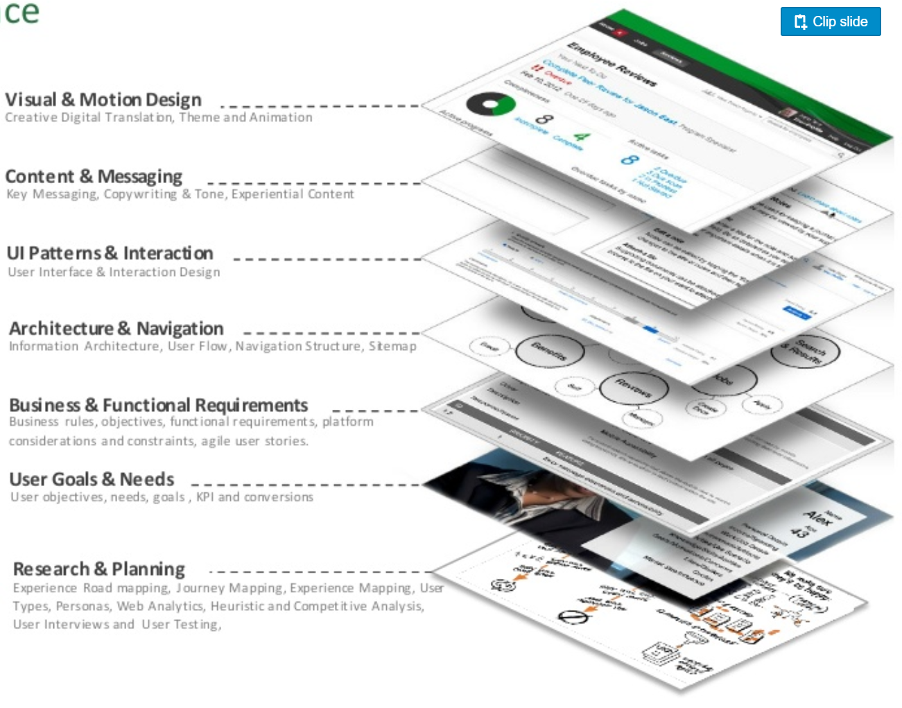
When to think about Accessibility
Validate code
Validate contrasts...
Validate text, links...
Validating interactions
Validate terminology
Evaluating effort
List disability
Select level
https://medium.com/@satyajitthakur/user-experience-content-strategy-dd89bb5479e9
Notes:
You should think about accessibility from the very beginning of a project — ideally, during the initial planning and requirement gathering phase.
Integrating accessibility early ensures that inclusivity is built into the design, user experience, and technical architecture from the outset, rather than trying to retrofit solutions later.
This proactive approach helps avoid costly rework, ensures compliance with regulations, and delivers a better experience for all users.
Additionally, continuous consideration throughout development, testing, and post-launch phases is essential for maintaining and improving accessibility.

Slide 85
Stages
4. MAINTAIN
Train
Evangelize / engage
Rise to maturity
1. AUDIT
Select level A, AA or AAA
Define objectives: legal compliance, certification, etc.
Auditing 20-25 pages + files + videos
Audit reused components (styleguide, design system)
Diagnostic user testing
The path to a11y remediation
PROMOTE
DECIDE
3. ACT
Training
Identify all occurrences
Remedy (priority to reused components)
2. PLAN
Setting priorities and deadlines
Allocating responsibilities
Organizing workflow and collaboration
Notes:
Building a structured path to accessibility remediation—covering audit, decision, planning, action, promotion, and ongoing maintenance—is essential because it ensures a systematic, efficient, and sustainable approach to achieving and sustaining compliance.
This process helps identify issues early, prioritize actions effectively, allocate the right resources, and track progress transparently.
It also fosters a culture of continuous improvement, making accessibility an integral part of your organization’s operations rather than a one-time project.
Ultimately, it leads to better user experiences, legal compliance, and an inclusive digital environment for all.

Slide 86
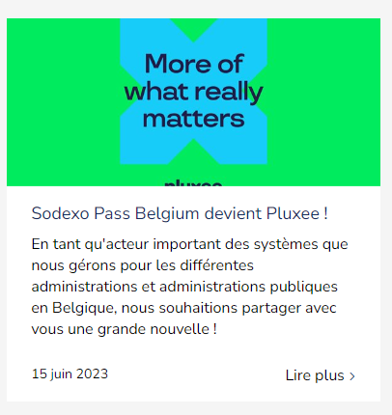
Organizing Collaboration
Information exchange
Copywriters, designers and developers will have to exchange information. They must have exchange areas (e.g. meetings/sprint, Jira, etc.).
Ex: Text alternatives
The designer imagines a page with images
The copywriter writes text alternatives for these images (for visitors who don't see them).
The developer has to find all these texts and integrate them into his code.
Home | ALE Brussels (sodexo.be)
Notes:
Organizing collaboration between copywriters, designers, and developers in an accessibility project involves establishing clear communication channels, shared goals, and integrated workflows.
Typically, this includes:
Early Planning: Involving all stakeholders from the project’s inception to define accessibility requirements, goals, and responsibilities.
Regular Coordination: Holding cross-disciplinary meetings, briefings, or stand-ups to ensure everyone understands their roles and progress.
Shared Guidelines and Documentation: Using common accessibility standards (e.g., WCAG) and documentation to maintain consistency.
Design-Development Alignment: Designers create accessible UI prototypes and guidelines, which developers implement and verify against technical standards.
Content-Design Sync: Copywriters craft accessible content (alt texts, clear language), working closely with designers to ensure visual and textual accessibility.
Testing and Feedback: Incorporating frequent testing (manual, automated, user testing) with input from all roles to identify issues and iterate.
This collaborative approach ensures that accessibility is embedded at every stage, creating a cohesive, inclusive, and compliant digital experience.

Slide 87
03. Agility
https://france-handicap-info.com/international/actualites-internationales-journees-mondiales/180-journee-mondiale-/5034-le-braille-plus-de-siecles-d-existence-a-t-il-encore-un-avenir-a-l-heure-du-tout-numerique
Notes:
An agile approach allows teams to adapt quickly, incorporate feedback frequently, and iteratively improve solutions.
This flexibility ensures that accessibility remains a priority throughout the project lifecycle, enabling proactive adjustments, faster problem resolution, and ultimately delivering inclusive digital experiences that meet current standards and user expectations efficiently.

Slide 88
Project Phase
Ensure the competence of business teams
Ensuring technological choices
Assess the need for external training and/or support
Anticipating solutions to the most complex problems
Planning accessibility interventions
Evaluate the need to equip the team
1. Initiating the project
2. Design phase
3. Development phase
4. Publication and go-live
5. Maintain accessibility
Maintenance and upgrading
New content production
Processing user feedback and bugs
Recurring audits
KPI tracking
Integrate a11y into detailed functional specifications
Mock-ups, prototypes and wireframes
Integrating the a11y into the style guide, the design system
Validate designs and content
Final sample audit
Accessibility declaration
Integrating a11y into templates and templates
Use of component libraries (e.g. Boostrap...)
Development validation
Notes:
In Agile teams, accessibility should be included in every step:
Define accessibility requirements in user stories.
Use a design system with accessible components.

Slide 89
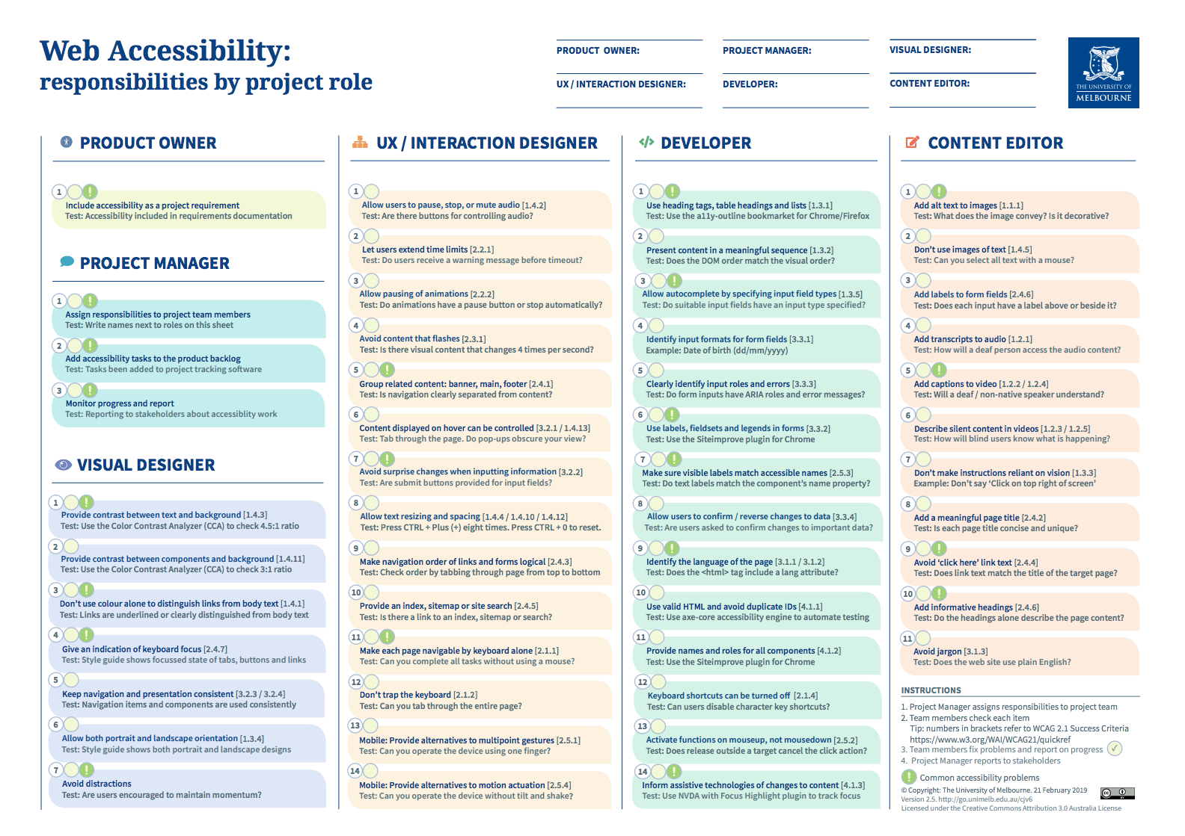
Project roles and responsibilities
Defining responsibilities by project role—such as designers, developers, content creators, testers, and project managers—ensures that each team member understands their specific tasks and contributions.
https://www.unimelb.edu.au/__data/assets/pdf_file/0005/2777567/responsibilities-20190219.pdf
Notes:
When roles and responsibilities are clearly assigned, teams understand their specific tasks, deadlines, and how they contribute to the overall goal.
Defining responsibilities by project role—such as designers, developers, content creators, testers, and project managers—ensures that each team member understands their specific tasks and contributions.
This role-based clarity promotes accountability, streamlines workflow, reduces overlaps or gaps, and fosters effective collaboration.
It helps ensure that all aspects of accessibility are systematically addressed, leading to successful compliance and a truly inclusive digital experience.

Slide 90
Project roles and responsibilities
Product owner
Include accessibility as a project requirement Test: Accessibility included in requirements documentation
Project Manager
Assign responsibilities to project team members Test: Write names next to roles on this Sheet
Add accesibility tasks to the product backlog Test: Tasks been added to project tracking software
Monitor progress and report Test: Reporting to stakeholders about accessibility work
Notes:
When roles and responsibilities are clearly assigned, teams understand their specific tasks, deadlines, and how they contribute to the overall goal.
Defining responsibilities by project role—such as designers, developers, content creators, testers, and project managers—ensures that each team member understands their specific tasks and contributions.
This role-based clarity promotes accountability, streamlines workflow, reduces overlaps or gaps, and fosters effective collaboration.
It helps ensure that all aspects of accessibility are systematically addressed, leading to successful compliance and a truly inclusive digital experience.

Slide 91
Project roles and responsibilities
Visual Designer
Provide contrast between text and background Test: Use the Color Contrast Analayzer (CCA) to check 4.5:1 ratio
Provide contrast between components and background Test: Use the Color Contrast Analayzer (CCA) to check 3:1 ratio
Don’t use colour alone to distinguish links from body text Test: Links are underlined or clearly distinguished from body text
Give an indication of keyboard focus Test: Style guide shows focussed state of tabs, buttons and links
Notes:
When roles and responsibilities are clearly assigned, teams understand their specific tasks, deadlines, and how they contribute to the overall goal.
Defining responsibilities by project role—such as designers, developers, content creators, testers, and project managers—ensures that each team member understands their specific tasks and contributions.
This role-based clarity promotes accountability, streamlines workflow, reduces overlaps or gaps, and fosters effective collaboration.
It helps ensure that all aspects of accessibility are systematically addressed, leading to successful compliance and a truly inclusive digital experience.

Slide 92
Project roles and responsibilities
Visual Designer
Keep navigation and presentation consistent Test: navigation items and components are used consistently
Allow both portrait and landscape orientation Test: style guide shows both portrait and landscape designs
Avoid distractions Test: Are users encouraged to maintain momentum?
Notes:
When roles and responsibilities are clearly assigned, teams understand their specific tasks, deadlines, and how they contribute to the overall goal.
Defining responsibilities by project role—such as designers, developers, content creators, testers, and project managers—ensures that each team member understands their specific tasks and contributions.
This role-based clarity promotes accountability, streamlines workflow, reduces overlaps or gaps, and fosters effective collaboration.
It helps ensure that all aspects of accessibility are systematically addressed, leading to successful compliance and a truly inclusive digital experience.

Slide 93
Project roles and responsibilities
UX/Interaction designer
Allow users to pause, stop or mute audio Test: Are there buttons for controlling audio?
Let users extend time limits Test: Do users receive a warning message before timeout?
Allow pausing of animations Test: Do animations have a pause button or stop automatically?
Avoid content that flashes Test: Is there visual content that changes 4 times per second?
Notes:
When roles and responsibilities are clearly assigned, teams understand their specific tasks, deadlines, and how they contribute to the overall goal.
Defining responsibilities by project role—such as designers, developers, content creators, testers, and project managers—ensures that each team member understands their specific tasks and contributions.
This role-based clarity promotes accountability, streamlines workflow, reduces overlaps or gaps, and fosters effective collaboration.
It helps ensure that all aspects of accessibility are systematically addressed, leading to successful compliance and a truly inclusive digital experience.

Slide 94
Project roles and responsibilities
UX/Interaction designer
Group relevant content: banner, main, footer Test: Is navigation clearly seperated from content?
Content displayed on hover can be controlled Test: Tab through the page. Do pop-ups obscure your view?
Avoid surprise changes when in putting information Test: Are submit buttons provided for input fields?
Allow test resizing and spacing Test: Press Ctrl + Plus (+) eight times. Press Ctrl + 0 to reset
Notes:
When roles and responsibilities are clearly assigned, teams understand their specific tasks, deadlines, and how they contribute to the overall goal.
Defining responsibilities by project role—such as designers, developers, content creators, testers, and project managers—ensures that each team member understands their specific tasks and contributions.
This role-based clarity promotes accountability, streamlines workflow, reduces overlaps or gaps, and fosters effective collaboration.
It helps ensure that all aspects of accessibility are systematically addressed, leading to successful compliance and a truly inclusive digital experience.

Slide 95
Project roles and responsibilities
UX/Interaction designer
Make navigation order of links and forms logical Test: Check order bij tabbing through page from top to bottom
Provide an index, sitemap or site search Test: Is there a link to an index, sitemap or search?
Make each page navigable by keyboard alone Test: Can you complete all tasks without using a mouse?
Don’t trap the keyboard Test: Can you tab through the entire page?
Mobile: Provide alternatives to multipoint gestures Test: Can you operate the device using one finger?
Moble: Provide alternaties to motion acuation Test: can you operate the device without tilt and shake?
Notes:
When roles and responsibilities are clearly assigned, teams understand their specific tasks, deadlines, and how they contribute to the overall goal.
Defining responsibilities by project role—such as designers, developers, content creators, testers, and project managers—ensures that each team member understands their specific tasks and contributions.
This role-based clarity promotes accountability, streamlines workflow, reduces overlaps or gaps, and fosters effective collaboration.
It helps ensure that all aspects of accessibility are systematically addressed, leading to successful compliance and a truly inclusive digital experience.

Slide 96
Project roles and responsibilities
Developer
Use heading tags, table headings and lists Test: Use the a11y-outline bookmarket for Chrome/Firefox
Present content in a meaningful sequence Test: Does the DOM order match the visual order?
Allow autocomplete by specifying input field type Test: Do suitable input fields have an input type specified?
Identify input formats for form fields Example: Date of birth (dd/mm/yyyy)
Clearly identify input roles and errors Test: Do form inputs have ARIA roles and error messages?
Notes:
When roles and responsibilities are clearly assigned, teams understand their specific tasks, deadlines, and how they contribute to the overall goal.
Defining responsibilities by project role—such as designers, developers, content creators, testers, and project managers—ensures that each team member understands their specific tasks and contributions.
This role-based clarity promotes accountability, streamlines workflow, reduces overlaps or gaps, and fosters effective collaboration.
It helps ensure that all aspects of accessibility are systematically addressed, leading to successful compliance and a truly inclusive digital experience.

Slide 97
Project roles and responsibilities
Developer
Use labels, fieldsets and legends in forms Test: Use the Siteimprove plugin for Chrome
Make sure visible labels match accessible names Test: Do text labels match the component’s name property?
Allow users to confirm/reverse changes to data Test: Are users asked to confirm changes to important data?
Identify the language of the page Test: Does the <html> tag cinclue a lang attribute?
Use valid HTML and avoid duplicate Ids Test: Use axe-core accessibility engine to automate testing
Notes:
When roles and responsibilities are clearly assigned, teams understand their specific tasks, deadlines, and how they contribute to the overall goal.
Defining responsibilities by project role—such as designers, developers, content creators, testers, and project managers—ensures that each team member understands their specific tasks and contributions.
This role-based clarity promotes accountability, streamlines workflow, reduces overlaps or gaps, and fosters effective collaboration.
It helps ensure that all aspects of accessibility are systematically addressed, leading to successful compliance and a truly inclusive digital experience.

Slide 98
Project roles and responsibilities
Developer
Provide names and roles for all components Test: use the siteimprove plugin for Chrome
Keyboard shortcuts can be turned off Test: can users isable character key shortcuts?
Activate functions on mouseup, not mousedown Test: does release outside a target cancel the click action?
Inform assistive technologies of changes to content Test: use NVDA with Focus Higlight plugin to track focus
Notes:
When roles and responsibilities are clearly assigned, teams understand their specific tasks, deadlines, and how they contribute to the overall goal.
Defining responsibilities by project role—such as designers, developers, content creators, testers, and project managers—ensures that each team member understands their specific tasks and contributions.
This role-based clarity promotes accountability, streamlines workflow, reduces overlaps or gaps, and fosters effective collaboration.
It helps ensure that all aspects of accessibility are systematically addressed, leading to successful compliance and a truly inclusive digital experience.

Slide 99
Project roles and responsibilities
Content Editor
Add alt text to images Test: What does the image convey? Is it decorative?
Dont use images of text Test: can you select all text with a mouse?
Add labels fo form fields Test: Does each input have a label above or beside it?
Add transcript to audio Test: How will a deaf person access the audio content?
Add captions to video Test: Will a deaf/ non-native speaker understand?
Describe silent content in videos Test: how will blind users know what is happening?
Notes:
When roles and responsibilities are clearly assigned, teams understand their specific tasks, deadlines, and how they contribute to the overall goal.
Defining responsibilities by project role—such as designers, developers, content creators, testers, and project managers—ensures that each team member understands their specific tasks and contributions.
This role-based clarity promotes accountability, streamlines workflow, reduces overlaps or gaps, and fosters effective collaboration.
It helps ensure that all aspects of accessibility are systematically addressed, leading to successful compliance and a truly inclusive digital experience.

Slide 100
Project roles and responsibilities
Content Editor
Don’t make instructions reliant on vision Example: Don’t say « Click on top right of screen »
Add a meaningful page title Test: Is each page title concise and unique?
Avoid « click here » link text Test: Does link text match the title of the target page?
Add informative headings Test: Do the headings alone describe the page content?
Avoid jargon Does the web site use plain English?
Notes:
When roles and responsibilities are clearly assigned, teams understand their specific tasks, deadlines, and how they contribute to the overall goal.
Defining responsibilities by project role—such as designers, developers, content creators, testers, and project managers—ensures that each team member understands their specific tasks and contributions.
This role-based clarity promotes accountability, streamlines workflow, reduces overlaps or gaps, and fosters effective collaboration.
It helps ensure that all aspects of accessibility are systematically addressed, leading to successful compliance and a truly inclusive digital experience.

Slide 101
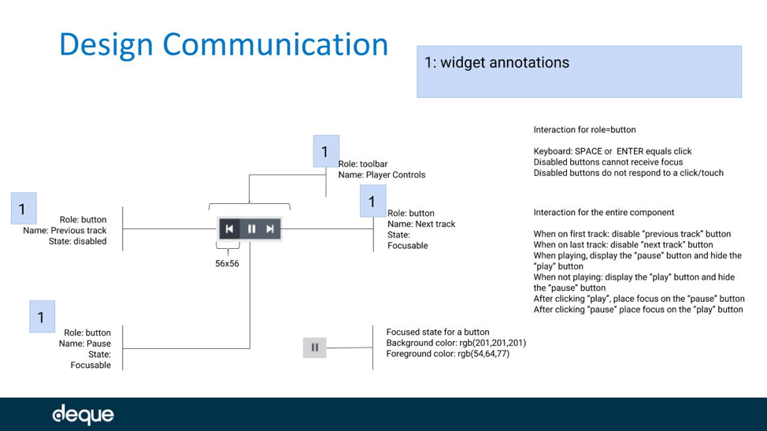
Collaboration
Ex: Collaborative design: annotation of interactions and accessible styles
Focus
Alternative
Mouse-free interaction
Active status
Focus status
…
https://www.deque.com/blog/accessibility-in-agile-team-practices

Slide 102
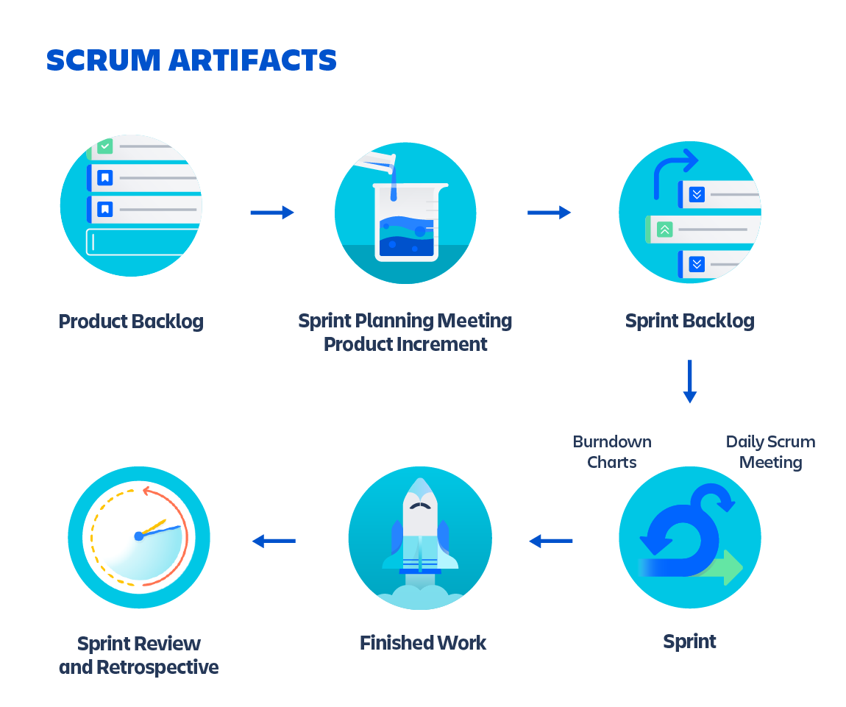
Artifacts and Activities
Requirements from the outset and throughout​
Participate in technical and design choices​
Integrating a11y into translation​
Integrating a11y into QA (Quality Assurance)
https://www.atlassian.com/agile/scrum/artifacts

Slide 103
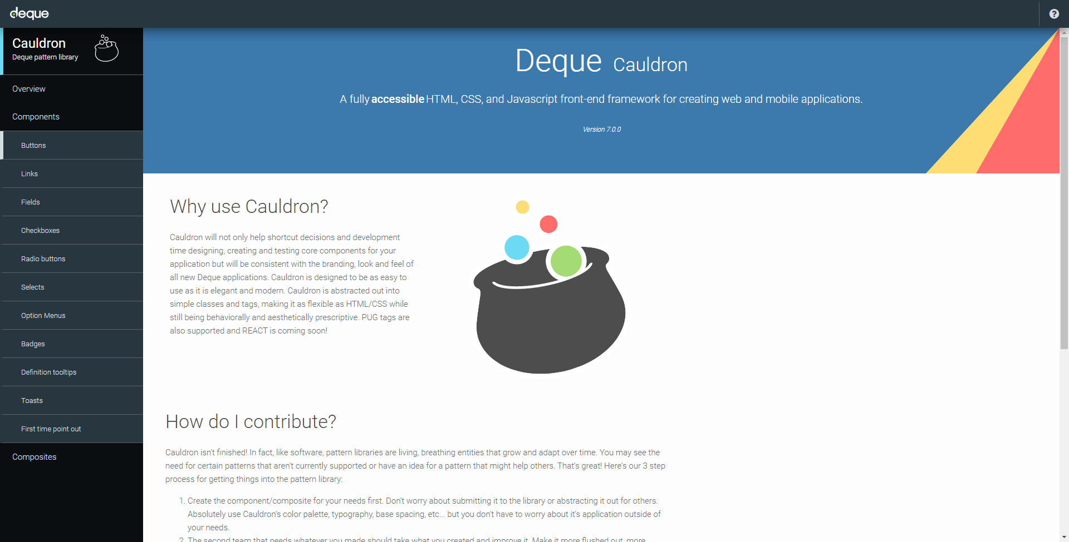
Speed
Design system and patterns
https://pattern-library.dequelabs.com/
Notes:
Designing accessible systems involves incorporating accessibility principles into every phase of your design process.
Establish Clear Guidelines: Integrate accessibility standards (like WCAG) into your design principles and documentation to ensure all team members are aligned.
Use Inclusive Components: Develop reusable UI components that comply with accessibility best practices—such as proper labels, focus management, color contrast, and keyboard navigability.
Embed Accessibility in Design Tools: Incorporate accessibility checks within design tools (Figma, Sketch) to flag issues early in the design phase.
Create a Shared Vocabulary: Use common language and symbols for accessibility features across teams to promote consistent implementation.
Involve Accessibility Experts: Collaborate with accessibility specialists during design reviews and testing to identify and address potential issues.
Conduct User Testing: Regularly test prototypes with users with disabilities to gather real-world feedback and refine components.
Provide Ongoing Training: Educate designers on accessibility best practices and keep the team updated on new standards or technologies.

Slide 104
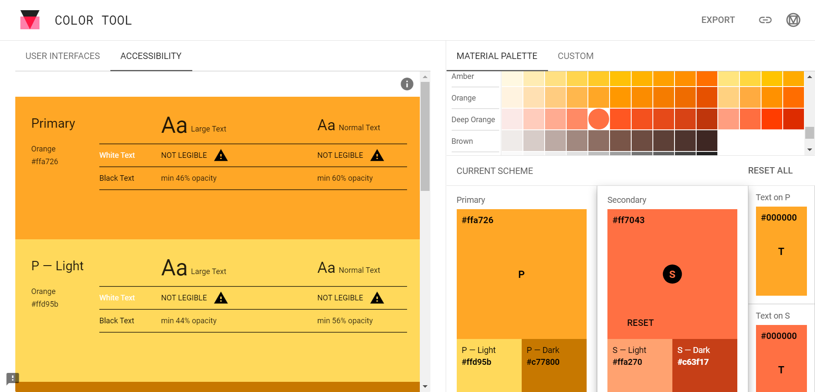
Autonomy
Provide business-specific test tools
https://material.io/resources/color/
Notes:
Autonomy in accessibility testing is valuable and crucial because it empowers teams to continuously evaluate and improve their digital products without always relying on external experts.
It fosters a culture of responsibility and awareness, enabling rapid identification and resolution of issues early in the development cycle.
This independence helps maintain compliance over time, reduces long-term costs, and ensures that accessibility becomes an integral part of daily workflows—ultimately delivering more inclusive, user-friendly experiences and demonstrating genuine organizational commitment to accessibility.

Slide 105
04. Corporate maturity
https://france-handicap-info.com/international/actualites-internationales-journees-mondiales/180-journee-mondiale-/5034-le-braille-plus-de-siecles-d-existence-a-t-il-encore-un-avenir-a-l-heure-du-tout-numerique
Notes:
Corporate maturity in accessibility refers to the level of integration, awareness, and proactive management of accessibility practices within an organization.
It measures how advanced a company is in embedding accessibility into its culture, processes, and strategy.

Slide 106
Accessibility is a journey, not a stage
"Accessibility is a journey, not a stage" because true organizational maturity in accessibility is an ongoing, evolving process rather than a one-time achievement.
It recognizes that accessibility involves continuous learning, improvement, and adaptation as standards, technologies, and user needs change over time.
Just like a journey, it requires a long-term commitment, regular assessments, and incremental progress, rather than reaching a single point of compliance and stopping.
This mindset encourages organizations to embed accessibility as a core, ongoing part of their culture and strategy.
https://france-handicap-info.com/international/actualites-internationales-journees-mondiales/180-journee-mondiale-/5034-le-braille-plus-de-siecles-d-existence-a-t-il-encore-un-avenir-a-l-heure-du-tout-numerique
Notes:
"Accessibility is a journey, not a stage" because true organizational maturity in accessibility is an ongoing, evolving process rather than a one-time achievement.
It recognizes that accessibility involves continuous learning, improvement, and adaptation as standards, technologies, and user needs change over time.
Just like a journey, it requires a long-term commitment, regular assessments, and incremental progress, rather than reaching a single point of compliance and stopping.
This mindset encourages organizations to embed accessibility as a core, ongoing part of their culture and strategy.

Slide 107
Roadmap A11Y
1 | 2 | 3 | 4 | 5
Allies | 1st successes | Features | Development and maintenance | Document and grow
Identify supporters, leaders, evangelists.
Correct components of commonly used templates: small task, big impact.
Find tools to systematize testing.
Correct key funnels.
Perform manual tests.
Schedule regular audits.
Document effective processes.

Slide 108
Maturity Model A11Y
Unknown
Defined
Repeatable
Managed
Optimized
No sensitivity
No internal mandate
Low individual sensitivity (legal obligation)
Product action
Accessibility of new products only
No budget allocated
Some IT training courses
Some collaborations between teams
Involvement of management
Process documentation a11y
Remediation of old products
Budget planning
Regular/advanced training
Public commitment
Strategic program and follow-up
Inclusive practices (not just digital)
Investment policy
External evangelization
Contributing to standards and innovation
Notes:
In accessibility, a mature organization typically:
Has clear policies and dedicated leadership around accessibility.
Incorporates accessibility from the earliest stages of design, development, and content creation.
Regularly trains staff and involves stakeholders across departments.
Performs ongoing audits, testing, and improvements.
Communicates transparently about accessibility efforts and progress.
Complies with legal requirements and often exceeds minimum standards.
Higher maturity indicates a deep organizational commitment to inclusion, ensuring accessibility is seen not just as a compliance task but as a core value driving innovation and user-centricity.

Slide 109
05. Conclusion

Slide 110
Evaluation of a Project in A11Y
Had you correctly assessed the accessibility load?​
Which position was the most overrun?​
Looking back, what were the mistakes?​
…​
Notes:
It is also good to evaluate every project for accessibility and to ask the right questions, using the answers to improve.

Slide 111
My Lines of Action
As ... | I can start tomorrow...
 | 1.
 | 2.
 | 3.
 | 4.
 | 5.
Notes:
canvas

Slide 112
Summary
In this lesson, we focused on making digital experiences inclusive and usable for all.
You discovered that accessibility isn't just about compliance — it's about empathy and responsibility.
Whether users have visual, auditory, motor, or cognitive impairments, your design choices can make a huge difference.
We explored WCAG principles (Perceivable, Operable, Understandable, Robust), common barriers, and testing,
Remember: Accessible design is better design. It improves usability for everyone and reflects a commitment to ethical, user-centered work.
Keep accessibility top of mind in every project — it's not an add-on, it's essential.

Slide 113
Resources & Additional reading
Online Tools & Resources
WebAIM(https://webaim.org/): Accessibility testing & best practices
Google Lighthouse (https://developers.google.com/web/tools/lighthouse/): Automated accessibility auditing tool
Color Contrast Accessibility Validator (https://www.tpgi.com/color-contrast-checker/): Ensures sufficient contrast
https://www.browserstack.com/guide/wcag-for-designers

Slide 114
Resources & Additional reading
Books
Accessibility for Everyone – Laura Kalbag
Inclusive Design for a Digital World – Regine M. Gilbert
Disability Visibility: First-Person Stories from the 21st Century – Alice Wong

Slide 115
Resources & Additional reading
Guidelines & Design Systems
WCAG 2.2 Guidelines (https://www.w3.org/TR/WCAG22/)
Material Design Accessibility (https://material.io/design/usability/accessibility.html)
IBM Carbon Design System (https://www.carbondesignsystem.com/)

Slide 116
Resources & Additional reading
Articles & Blogs
Deque Blog (https://www.deque.com/blog/): Best practices & latest trends in accessibility
Smashing Magazine (https://www.smashingmagazine.com/category/accessibility/): Accessibility insights for designers & developers

Slide 117
Do you have any questions?

Slide 118
Thank you for your attention

